Slide 1
Dichotomous Key

Slide 2
Which Bird is Yours?

Slide 3
1. Does your bird have a long neck?
Yes go to -> 2
No go to -> 5

Slide 4
2. Does your bird have black mask?
Yes go to -> 3
No go to ->4

Slide 5
SWAN

Slide 6
Heron

Slide 7
5. Does your bird have a long beak?
Yes go to -> 6
No go to -> 9

Slide 8
Woodpecker

Slide 9
Kingfisher

Slide 10
9. Does your bird have brown feathered wings?
Yes go to -> 10
No go to -> 13

Slide 11
10. Does your bird have a redish-orange chest.
Yes go to -> 11
No go to ->12

Slide 12
Robin

Slide 13
Nightingale

Slide 14
13. Does your bird have black feathers all over?
Yes go to -> 14
No go to -> 15

Slide 15
Raven

Slide 16
15. Is your bird known for being a predator, larger in reality then the rest?
Yes go to ->16
No go to -> 19

Slide 17
16. Does your bird have a short tail?
Yes go to -> 17
No go to -> 18

Slide 18
Eagle

Slide 19
Hawk

Slide 20
19. Does your bird have a famous soap brand named after it?
Yes go to -> 20
No go to-> 21

Slide 21
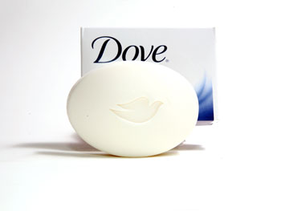
Dove

Slide 22
21. Is your bird’s name related to the feather on it?
Yes go to -> 22
No got to -> 23

Slide 23
Goldfinch

Slide 24
Kestrel

